Slide 1
Steganography with aes encryption & Decryption
CAPSTONE PROJECT
Presented By: Ayush Subba
Student Name : Ayush Subba
College Name & Department : Salesian College Siliguri/ Computer Applications

Slide 2
OUTLINE
Problem Statement
Technology used
Wow factor
End users
Result
Conclusion
Git-hub Link
Future scope

Slide 3
Problem Statement
In an era of increasing digital surveillance and cybersecurity threats, securing private communications has become a major challenge.
Traditional encryption methods may raise suspicion, while unsecured messages are vulnerable to interception.
This project addresses this issue by combining steganography and AES encryption to securely hide messages within images, making them invisible to unauthorized users.

Slide 4
Technology used
OpenCV: Used for image processing(pip install opencv-python)
NumPy: Handles numerical operations on images(pip install numpy)
PyCryptodome: Implements AES encryption. (pip install pycryptodome)

Slide 5
Wow factors
The user inputs a secret message and passcode.
The message is encrypted using AES.
The encrypted message is converted into ASCII values.
These values are embedded into the least significant bits of the image pixels.
The modified image is saved as an encoded image

Slide 6
End users
Cybersecurity Enthusiasts & Researchers
Journalists & Whistleblowers
Forensic Investigators & Law Enforcement
Government & Military Personnel
Artists & Content Creators
General Users Concerned About Privacy
Software Developers & Cryptographers

Slide 7
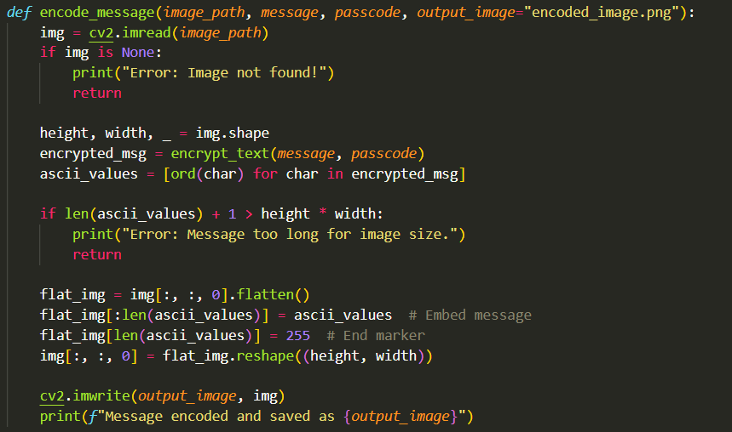
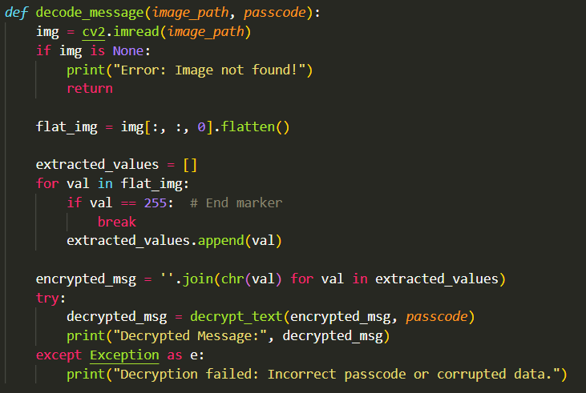
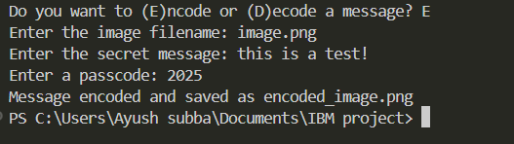
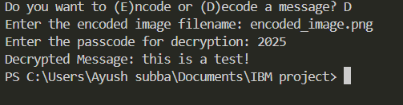
Results
ENCRYPT Code
DECRYPT Code
This is how we can encode/encrypt the image.
This is how we can decode/decrypt the image.

Slide 8
Conclusion
This project successfully demonstrates the integration of steganography and encryption to achieve secure communication.
By embedding AES-encrypted messages into images, the program enhances data security while keeping messages hidden from unauthorized users.

Slide 9
GitHub Link
https://github.com/ayushwastaken/StegoProject

Slide 10
Future scope(optional)
Future enhancements may include:
Support for multiple image formats.
Implementing different encryption techniques.
Hiding messages in other color channels or using advanced steganographic techniques.
This solution provides a reliable and effective method for secure information exchange, making it valuable for cybersecurity, digital forensics, and personal data protection.

Slide 11
THANK YOU

